Slide 1

Wiring beans

Slide 2
Declaring beans
Any nontrivial application is made up of several objects that must work together to meet some business goal.
These objects must be aware of one another and communicate with one another to get their jobs done.
In an online shopping application, for instance, an order manager component may need to work with a product manager component and a credit card authorization component.
All of these will likely need to work with a data access component to read from and write to a database

Slide 3
Declaring beans
The traditional approach to creating associations between application objects (via construction or lookup) leads to complicated code that’s difficult to reuse and unit test.
At best, these objects do more work than they should.
At worst, they’re highly coupled to one another, making them hard to reuse and hard to test.
In Spring, objects aren’t responsible for finding or creating the other objects that they need to do their jobs.
Instead, they’re given references to the objects that they collaborate with by the container.

Slide 4
Declaring beans
An order manager component, for example, may need a credit card authorizer—but it doesn’t need to create the credit card authorizer.
It just needs to show up empty-handed and it’ll be given a credit card authorizer to work with.
The act of creating these associations between application objects is the essence of dependency injection (DI) and is commonly referred to as wiring.
In this lecture, we will focus on the basics of bean wiring using Spring.
As DI is the most elemental thing Spring does, these are techniques you’ll use almost every time you develop Spring-based applications.

Slide 5
Declaring beans
Spring is a container-based framework. But if you don’t configure Spring, then it’s an empty container and doesn’t serve much purpose.
We need to configure Spring to tell it what beans it should contain and how to wire those beans so that they can work together.
As of Spring 3.0, there are two ways to configure beans in the Spring container.
Traditionally, Spring configuration is defined in one or more XML files.
But as of Spring 3.0, it also offers a Java-based configuration option. We’ll focus on the traditional XML option for now

Slide 6
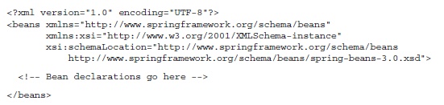
Declaring beans
When declaring beans in XML, the root element of the Spring configuration file is the <beans> element from Spring’s beans schema.
A typical Spring configuration XML file looks like this:
Within the <beans> you can place all of your Spring configuration, including <bean> declarations.

Slide 7
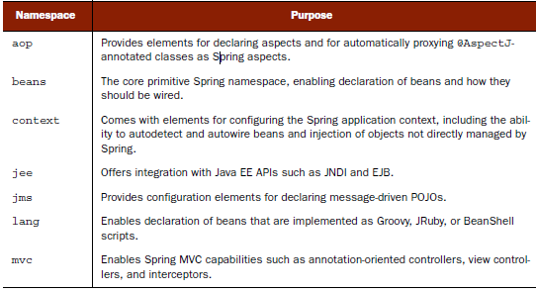
Declaring beans
The beans namespace isn’t the only Spring namespace you’ll encounter. Other include:

Slide 8

Declaring beans
Let us declare simple bean. Fist of all, let assume that we have Performer interface:
One of the performers can be a Juggler, who juggles with beanBags

Slide 9
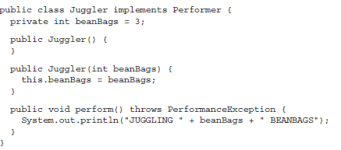
Declaring beans

Slide 10
Declaring beans
As you can see, this Juggler class does little more than implement the Performer interface to report that it’s juggling some beanbags.
By default, the Juggler juggles three beanbags, but can be given some other number of beanbags through its constructor.
With the Juggler class defined, please welcome our first performer, Duke, to the stage.
Duke is defined as a Spring bean. Here’s how Duke is declared in the Spring configuration file

Slide 11
Declaring beans
The <bean> element is the most basic configuration unit in Spring.
It tells Spring to create an object for you.
Here you’ve declared Duke as a Spring-managed bean using what’s nearly the simplest <bean> declaration possible.
The id attribute gives the bean a name by which it’ll be referred to in the Spring container.
This bean will be known as duke.
And, as you can see from the class attribute, Duke is a Juggler.

Slide 12

Declaring beans
When the Spring container loads its beans, it’ll instantiate the duke bean using the default constructor.
In essence, duke will be created using the following Java code:
new com.springinaction.springidol.Juggler();
To give Duke a try, you can load the Spring application context using the following code:

Slide 13
Declaring beans
When run, this code prints the following:
JUGGLING 3 BEANBAGS
By default, Duke juggles only three beanbags at once.
But juggling three beanbags isn’t all that impressive—anybody can do that.
If Duke is to have any hope of winning the talent competition, he’s going to need to juggle many more beanbags at once.
Let’s see how to configure Duke to be a champion juggler.

Slide 14
Injecting through constructors
To really impress the judges, Duke has decided to break the world record by juggling as many as 15 beanbags at once.
the Juggler class can be constructed in two different ways:
  Using the default constructor
  Using a constructor that takes an int argument which indicates the number of beanbags that the Juggler will attempt to keep in the air
Although the first declaration of the duke bean is valid, it uses the Juggler’s default constructor, which limits Duke to juggling only three beanbags at once.
To make Duke a world-record juggler, we’ll need to use the other constructor.

Slide 15

Injecting through constructors
The <constructor-arg> element is used to give Spring additional information to use when constructing a bean.
If no <constructor-arg>s are given, as in first example, the default constructor is used.
But here you’ve given a <constructor-arg> with a value attribute set to 15, so the Juggler’s other constructor will be used instead.

Slide 16
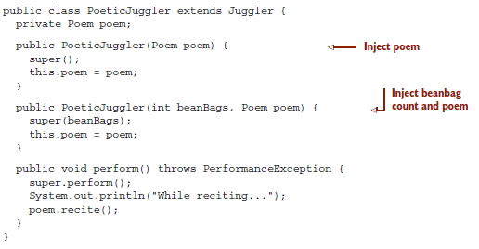
Injecting through constructors
We can inject object references with constructors as well
Let assume that our Duke is more than just an average juggler—he’s a poetic juggler—we need to define a new type of juggler for him to be: PoeticJuggler

Slide 17

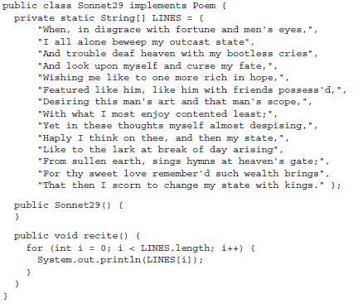
Injecting through constructors

Slide 18

Injecting through constructors
Sonnet29 can be declared as a Spring <bean> with the following XML:
With the poem chosen, all you need to do is give it to Duke. Now that Duke is a PoeticJuggler, his <bean> declaration will need to change slightly:

Slide 19
Injecting through constructors
The only way to construct a PoeticJuggler is to use a constructor that takes arguments, an int and a Poem
Bean declaration configures the number of beanbags as 15 through the int argument using <constructor-arg>’s value attribute
It is not possible to use value to set the second constructor argument because a Poem isn’t a simple type.
Instead, the ref attribute is used to indicate that the value passed to the constructor should be a reference to the bean whose ID is sonnet29.

Slide 20
Injecting through constructors
Spring container does much more than just construct beans, you may imagine that when Spring encounters the sonnet29 and duke <bean>s, it performs the following logic:
Poem sonnet29=newSonnet29();
Performerduke=newPoeticJuggler(15,sonnet29);

Slide 21

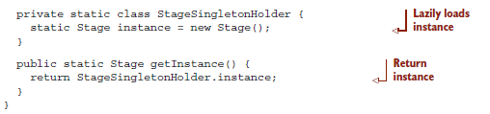
Factory methods
Sometimes the only way to instantiate an object is through a static factory method.
Spring is ready-made to wire factory-created beans through the <bean> element’s factory-method attribute.

Slide 22
Factory methods
Singleton classes generally ensure that only one instance is created by only allowing creation through a static factory method
Bean we want to declare doesn’t have a public constructor
We want to ensure that there’s only one stage for the performers to show their stuff.
Stage has been implemented as a singleton to ensure that there’s no way to create more than one instance of Stage
the static getInstance() method returns the same instance every time it’s called.

Slide 23

Factory methods
The <bean> element has a factory-method attribute that lets you specify a static method to be invoked instead of the constructor to create an instance of a class

Slide 24
Bean scoping
By default, all Spring beans are singletons.
When the container dispenses a bean (either through wiring or as the result of a call to the container’s getBean() method) it’ll always hand out the exact same instance of the bean
But there may be times when you need a unique instance of a bean each time it’s asked for
When declaring a <bean> in Spring, you have the option of declaring a scope for that bean.
To force Spring to produce a new bean instance each time one is needed, you should declare the bean’s scope attribute to be prototype

Slide 25
Bean scoping
By setting the scope attribute to prototype, we can be assured that a distinct instance will be given out to everyone who the ticket bean is wired into.
In addition to prototype, there are other scoping options, listed on the following slide

Slide 26
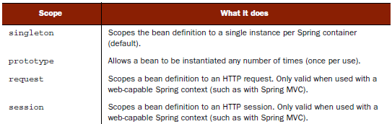
Bean scoping

Slide 27
Initializing and destroying beans
When a bean is instantiated, it may be necessary to perform some initialization to get it into a usable state.
Likewise, when the bean is no longer needed and is removed from the container, some cleanup may be in order.
To accommodate setup and tear-down of beans, Spring provides hooks into the bean lifecycle
To define setup and teardown for a bean, simply declare the <bean> with init-method and/or destroy-method parameters

Slide 28
Initializing and destroying beans
The init-method attribute specifies a method that is to be called on the bean immediately upon instantiation.
Similarly, destroy-method specifies a method that is called just before a bean is removed from the container.

Slide 29
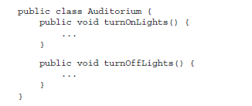

Initializing and destroying beans

Slide 30
Initializing and destroying beans
If many of the beans in a context definition file will have initialization or destroy methods with the same name, you don’t have to declare init-method or destroy-method on each individual bean.
Instead you can take advantage of the default-init-method and default-destroy-method attributes on the <beans> element
The default-init-method attribute sets an initialization method across all beans in a given context definition. Likewise, default-destroy-method sets a common destroy method for all beans in the context definition.

Slide 31
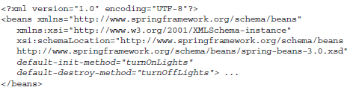
Initializing and destroying beans
We’re asking Spring to initialize all beans in the context definition file by calling turnOnLights() and to tear them down with turnOffLights() (if those methods exist – otherwise nothing happens).

Slide 32
Injecting into bean properties
Typically, a JavaBean’s properties are private and will have a pair of accessor methods in the form of setXXX() and getXXX().
Spring can take advantage of a property’s setter method to configure the property’s value through setter injection

Slide 33

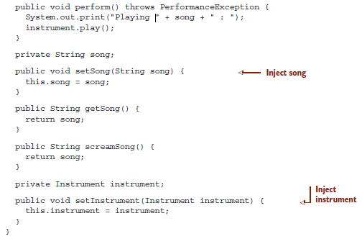
Injecting into bean properties

Slide 34
Injecting into bean properties
The Instrumentalist class has a default constructor, Kenny could be declared as a <bean> in Spring with the following XML
Although Spring will have no problem instantiating kenny as an Instrumentalist, Kenny will have a hard time performing without a song or an instrument
In this case we will use setter injection

Slide 35

Injecting into bean properties
Bean properties can be configured in Spring using the <property> element.
<property> is similar to <constructor-arg> in many ways, except that instead of injecting values through a constructor argument, <property> injects by calling a property’s setter method

Slide 36
Injecting into bean properties
Once the Instrumentalist has been instantiated, Spring will use property setter methods to inject values into the properties specified by <property> elements
In this case, the value attribute of the <property> element is used to inject a String value into a property. But <property> isn’t limited to injecting String values.
The value attribute can also specify numeric (int, float, java.lang.Double, and so on) values as well as boolean values.

Slide 37
Injecting into bean properties
Using <property> to configure simple properties of a bean is great, but there’s more to DI than just wiring hardcoded values.
The real value of DI is found in wiring an application’s collaborating objects together so that they don’t have to wire themselves together.
To that aim, let’s see how to give Kenny an instrument that he can play

Slide 38



Injecting into bean properties

Slide 39


Injecting into bean properties
With the saxophone declared, we’re ready to give it to Kenny to play.
The following modification to the kenny bean uses setter injection to set the instrument property
You can use Kenny with the following Java code

Slide 40
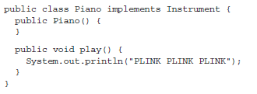
Injecting into bean properties
As mentioned, Kenny can play virtually any instrument that’s given to him as long as it implements the Instrument interface.
Although he favors the saxophone, we could also ask Kenny to play piano.
For example, consider the Piano class.

Slide 41


Injecting into bean properties
The Piano class can be declared as a <bean> in Spring using the following XML:
Now that a piano is available, changing Kenny’s instrument is as simple as changing the kenny bean declaration

Slide 42
Injecting inner beans
We’ve seen that Kenny can play saxophone, piano, or any instrument that implements the Instrument interface.
But it’s also true that the saxophone and piano beans could also be shared with any other bean by injecting them into an instrument property.
So, not only can Kenny play any Instrument, any Instrumentalist can play the saxophone bean.
In fact, it’s common for beans to be shared among other beans in an application.

Slide 43
Injecting inner beans
The problem is that Kenny’s concerned with the hygienic implications of sharing his saxophone with others.
He’d rather keep his saxophone to himself.
To help Kenny avoid germs, we’ll use a handy Spring technique known as inner beans.
As a Java developer, you’re probably already familiar with the concept of inner classes—classes that are defined within the scope of other classes.
Similarly, inner beans are beans that are defined within the scope of another bean.

Slide 44
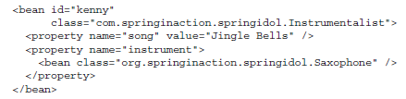
Injecting inner beans
An inner bean is defined by declaring a <bean> element directly as a child of <property> element to which it will be injected.
This will create Saxophone and wire it into Kenny’s instrument property.
It is possible to wire inner beans into constructor arguments as well.

Slide 45
Injecting inner beans
Note that the inner beans don’t have an id attribute set.
Though it’s perfectly legal to declare an ID for an inner bean, it’s not necessary because you’ll never refer to the inner bean by name.
This highlights the main drawback of using inner beans: they can’t be reused.
Inner beans are only useful for injection once and can’t be referred to by other beans.

Slide 46
p namespace
Wiring values and references into bean properties using the <property> element isn’t that daunting.
Nevertheless, Spring’s p namespace offers a way to wire bean properties that doesn’t require so many angle brackets.
The p namespace has a schema URI of http://www.springframework.org/schema/p.
To use it, simply add a declaration for it in the Spring XML configuration

Slide 47
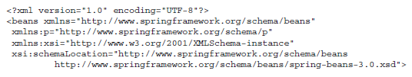

p namespace

Slide 48
p namespace
The choice between <property> and the p namespace is up to you.
They work equally well.
The primary benefit of the p namespace is that it’s more terse.

Slide 49
Wiring collections
We have seen how to use Spring to configure both simple property values (using the value attribute) and properties with references to other beans (using the ref attribute).
But value and ref are only useful when your bean’s properties are singular.
How can Spring help you when your bean has properties that are plural—what if a property is a collection of values?

Slide 50
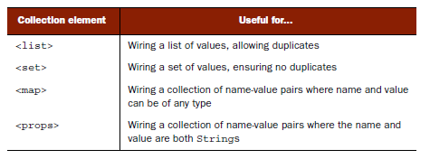
Wiring collections
Spring offers four types of collection configuration elements that come in handy when configuring collections of values

Slide 51
Wiring collections
The <list> and <set> elements are useful when configuring properties that are either arrays or some implementation of java.util.Collection.
The actual implementation of the collection used to define the property has little correlation to the choice of <list> or <set>.
Both elements can be used almost interchangeably with properties of any type of java.util.Collection.

Slide 52
Wiring collections
As for <map> and <props>, these two elements correspond to collections that are java.util.Map and java.util.Properties, respectively
They are very useful when you need a collection that’s made up of a collection of key-value pairs.
The key difference between the two is that when using <props>, both the keys and values are Strings, whereas <map> allows keys and values of any type.

Slide 53
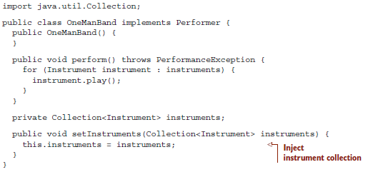
Wiring collections
Hank’s talent is playing several instruments, but Hank can play several instruments at the same time.
Hank is defined by the OneManBand class.

Slide 54
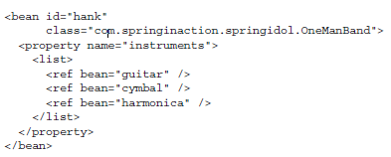
Wiring collections
To give Hank a collection of instruments to perform with, let’s use the <list> configuration element
The <list> element contains one or more values.

Slide 55
Wiring collections
<list> may be used with properties that are of any implementation of java.util.Collection or an array.
In other words, the <list> element we just used would still work, even if the instruments property were to be declared as:
java.util.List<Instrument> instruments;

Slide 56
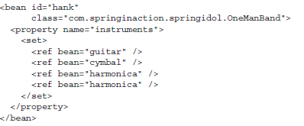
Wiring collections
Likewise, you could also use <set> to wire a collection or array property
Either <list> or <set> can be used to wire any implementation of java.util.Collection or an array

Slide 57
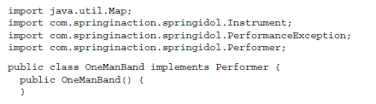
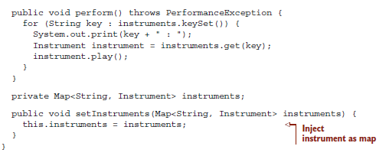
Wiring collections
Wiring maps:

Slide 58
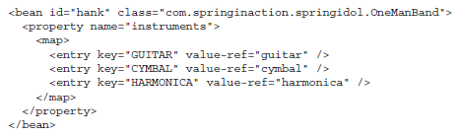
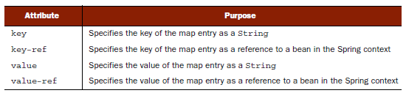
Wiring collections
Because a Map’s members are made up of key-value pairs, a simple <list> or <set> configuration element won’t suffice when wiring the property.

